Slide 1
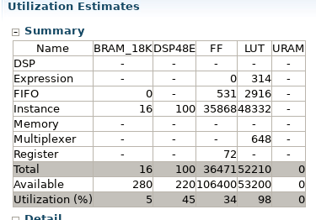
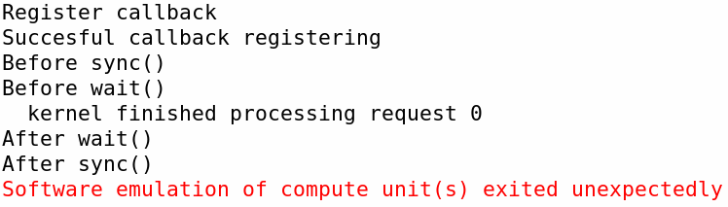
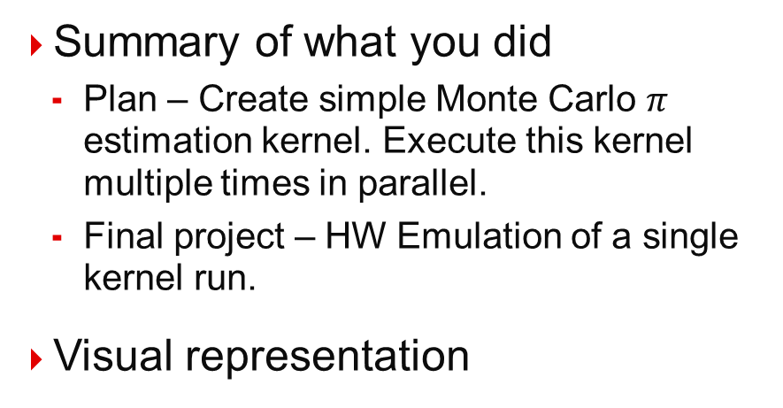
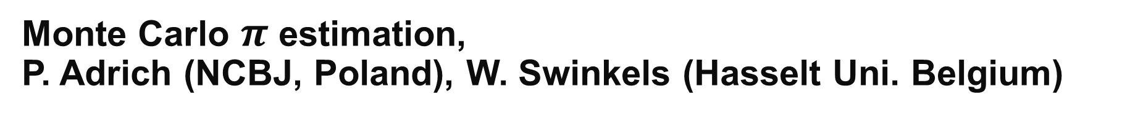
Monte Carlo $π$ estimation, P. Adrich (NCBJ, Poland), W. Swinkels (Hasselt Uni. Belgium)
Summary of what you did
Plan – Create simple Monte Carlo $π$ estimation kernel. Execute this kernel multiple times in parallel.
Final project – HW Emulation of a single kernel run.
Visual representation
What did you learn, or what was interesting/difficult?
Use the xf::fintech::MT19937 RNG
Gain insight in running multiple kernels in parallel
Results?

